Slide 1
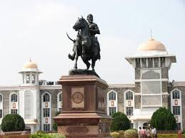
THE MAHARASHTRA PUBLIC UNIVERSITIES ACT 2016
A presentation by Adv (Dr.) Santosh A. Shah, Legal Advisor, Shivaji University, Kolhapur

Slide 2

> OBJECT OF ANY LAW :
To regulate human conduct and
To deal with mischief in society.
> INDIAN EDUCATION SYSTEM IS OVER REGULATED BUT UNDER GOVERNED.

Slide 3
DR. NIGAVEKAR COMMITTEE REPORT –
The University needs to have an open, flexible and transparent governance and administrative structure. It should also cultivate financial independence and a mechanism for quality and social audit.

Slide 4
PANDIT JAWAHARLAL NEHRU-
A University stands for humanism, for tolerance, for reason, for adventure of ideas and search for truth. It stands for onward march of human race towards even higher objectives. If the Universities discharge their duties adequately then it is well with the nation and the people.

Slide 5
PREAMBLE OF 2016 ACT :
Academic autonomy & Excellence
Adequate representation through democratic process
Transformation, strengthening and regulating higher education
Participation of Universities in social and education spheres.
Establishment of Maharashtra State Commission for Higher Education and Development.
To constitute various boards
To repeal the Maharashtra Universities Act, 1994.

Slide 10
PROVISIONS RELATING TO DISPUTE RESOLUTION
Sec. 9 : Chancellor and his powers
Sec. 48 (5) (a, b ) : Powers and Duties of Board of Examination:
To investigate and take disciplinary action relating to –
failure to comply with the order of University for rendering assistance or service in respect of examinations.
lapses on the part of candidates, paper setters, examiners, moderators, referees, teachers or any other persons connected with the examinations by a committee of not more than 5 persons.
Report of the Committee to the Vice- Chancellor and the Director Board of Examinations and Evaluation shall take disciplinary action as per the decision of the Vice- Chancellor.
The decision of the lapses Committee will therefore not come before the Board of Examinations.

Slide 11
SEC. 64 ( F & G) : DIS-QUALIFICATION FOR MEMBERSHIP OF AUTHORITY
Additional grounds –
Wilful omission or refusal to carry out the provisions of the Act, Statutes or ordinances or has acted in any manner detrimental to the interest of the University.
Has been punished in any form by the competent authority for committing a mis-conduct.

Slide 12
SEC.79 : GRIEVANCES COMMITTEE :
Does not apply to grievances against the State Government

Slide 14
Sec. 81 (1) (b) : Right of appeal to University & College Tribunal :
Decision of the grievances committee.

Slide 15
SEC. 6 : SECOND PROVISO :
Provision to establish sub campuses or centre or institutions in any foreign country on its own or in collaboration with any other Indian or foreign University or institution with the prior sanction of the Central and the State Government.

Slide 16
Sec2(48)Satellite Centre
(48) "satellite centre" means an integral part of an affiliated or conducted college or recognized institution imparting academic programmes, co-curricular, research and extension activities in rural or tribal region, neighbouring the location of such college or institution, established with the object of reaching the unreached, on the terms and conditions specified by the State Government by an Order in the Official Gazette;

Slide 17
Pro-Vice-Chancellor -Sec 13
(13) The Pro-Vice-Chancellor shall,— (a) be the principal academic planning and academic audit officer for the academic development programmes, including post-graduate teaching, research and extension programmes and collaborative programmes of the university;
(f) accord approval to the appointments of principals and teachers of affiliated colleges and institutions, autonomous colleges and institutions, empowered autonomous colleges, cluster of institutions and recognized institutions or withdraw the same in accordance with the procedure as prescribed in the Ordinances;
(g) accord approvals to selection committees for appointment of teachers in the colleges as per the norms of the University Grants Commission and the State Government;

Slide 18
Deans of Faculties: Fulltime salaried officers Responsible for academic planning and audit.
Sec. 16(f)- ensure that the teachers' appraisal by students is carried out and the reports thereof are sent to the university authorities concerned;

Slide 19
Sec.34(2) Faculty
The university shall have the following faculties, namely:— (i) Faculty of Science and Technology; (ii) Faculty of Commerce and Management; (iii) Faculty of Humanities; (iv) Faculty of Inter-disciplinary Studies.

Slide 20
Sec.56(2)(b) Student’s grievance redressal cell.
Students Grievance Redressal Cell,- There shall be Students Grievance Redressal Cell at the University and each college and recognized institutions to resolve the Grievances of Students and to suggest to the higher authorities different ways and means to minimize and prevent such grievances. The functional mechanism of working of Students Grievance Redressal Cell shall be as prescribed by Statutes, prepared in accordance with the provisions of the University Grants Commission (Grievance Redressal) Regulations, 2012, or any other regulations for the time being in force.

Slide 21
Sec.105(10)
The Selection Committee, selection process and mode of appointment of principals and teachers of affiliated colleges and recognized institutions shall be as per the guidelines, directions of the University Grants Commission as may be prescribed by the State Government in the Official Gazette.

Slide 22
SEC. 8 : CONTROL OF STATE GOVERNMENT ON UNIVERSITIES :
Power of State Government to cause inspection of any affiliated, conducted or autonomous collage, recognized institution or University department.

Slide 23
SEC. 12 : VICE CHANCELLORS POWERS :
Power to accord recognition as qualified teachers to the experts from the field of application oriented industries or companies and domain specific experts in various professional skills, working as training experts in private skills education providers and empowered skill development colleges.
Recommend to the State Government on the report of the Management Council temporarily alternative arrangements in the interest of students to run the day today academics and activities of the management of an affiliated college, institution or autonomous college of empowered autonomous colleges or cluster of institutions in case of disputes, criminal acts by the management, mis- management.

Slide 24
SEC. 29 : FUNCTIONS AND DUTIES OF SENATE :
To approve comprehensive perspective plan and annual plan for location of colleges and institutions of higher learning as recommended by the Academic Council.
To review and adopt the report of students, grievance reddressal report to be presented by the Registrar of the University.

Slide 25
Sec. 102 (9) : Selection and appointment of University teachers :
absorption of surplus teachers from other Universities
Sec 112 : Recognition of private education provider
Sec 113 : Recognition to empowered autonomous skills development colleges
Sec. 118 : Shifting college location within the same district within the periphery of 5 Kms.
Sec. 119 : Transfer of management of colleges and institutions

Slide 26
Chap XVI : Transitory provisions :
Sec. 145- Every employee holding office, whether teaching or other employee in the University shall continue to hold the said office on the same terms and conditions.
Sec. 146 – (1) All authorities to be re-constituted before 31st Aug 2017 .
(2) Every person holding office as a member of any authority continue to hold the said office until re- constitution of the said authority.
Sec. 148- If any difficulty arises in giving effect to the provisions of this Act, the State Government may by order publish in the official Gazattee remove the same for a period of 2 years from the commencement of the Act.

Slide 27
Reintroduction of university elections, setting up of students’ development councils (SDCs), choice-based credit system, cutting down of political appointments through nomination of experts, increasing social reservations in various university bodies, special emphasis on skill development, uniform regulatory regimen for all universities and introduction of modern accounting system. S14(6)(d), S.23(3)(k), S.67, S71(13), S.99(11)

Slide 28
To increase the say of students in university affairs, the Act proposes to appoint previous year’s topper in a particular faculty as a member of that faculty’s board of studies, nominating the president of university students’ council as invitee member of the management council, special exams for students required to participate in inter-university, national, international sports and cultural events, National Service Scheme and Rashtriya Chatrasena programmes etc. Among the major new suggestion is reintroduction of college and university election from the next academic session. S.28(q), S.30(6), S.40(e), S.99(g)

Slide 29
The Act proposes to strike a balance between elections and nominations to various university bodies to stamp out nominations of vested interests. Nominations will now be done after election of chairpersons of boards of studies as against the past practice, when nominated members would have a say in elections of such chairpersons as well as deans of various faculties. S.40,

Slide 30
The Act ushers in choice-based credit system, which will enable the students to chose any subject of their liking. There will be credit/gradation system in performance evaluation to allow students to study combination of subjects of their own choice. This will also facilitate their seamless shift from one university to another. S.5(1), S.5(16).

Slide 31
The Act proposes to nominate eight experts from nationally important institutes into academic councils. S.32

Slide 32
Another important provision in the Act is to increase social reservation in various bodies to give a greater say to various sections of the society in the university’s decision making process. Reservation in senate has been increased from nine seats to 14 and in management council from one to four. In academic council, positions of principal, professor and lecturer have also been provided with social reservation.

Slide 33
The Act lays major stress on entrepreneurship development through skill development. For this, the Act has introduced the idea of board of innovation, incubation and enterprise and board of national and international linkages. The boards will strive to bring in the latest in global entrepreneur skills to the universities. A senior manager from the lead bank of the university will be part of the innovation board. S.20, S.53

Slide 34
The Act has introduced “new concepts”, autonomous colleges, empowered autonomous colleges, empowered group institutions, private skills education institutions and cluster university. To leverage the advantages of information technology, the Act incorporates the A-3 society (anyone, anytime, anywhere) concept suggested by Anil Kakodkar. A new Board of Information Technology will be introduced at the university level to leverage advantages of information technology for teaching, studying and research. S.122

Slide 35
A new Faculty of Interdisciplinary Studies to facilitate interdisciplinary studies will also be introduced. S.42 and 43
The Act proposes to establish internal quality assurance boards as a precondition for quality assessment by NAAC and university grants commission. S.2.28, S.95

Slide 36
For grant of permission to new colleges, the new system will offer a letter of intent for the first year during which the colleges will have to complete infrastructure building and creation of facilities. After due scrutiny of the facilities, the university will then grant permission to run such colleges. S.109
The Act stresses on quick and proper redressal of students’ complaints, setting up of equal opportunity cell for disable students and setting up of a Vishakha cell to redress complaints of sexual harassment of women. S.56.g, S.73.10
To prevent profiteering by unaided institutions affiliated to universities, the Act proposes to set up special fee fixitation committee to determine fees and a regulatory mechanism at the state-level. S.101

Slide 37
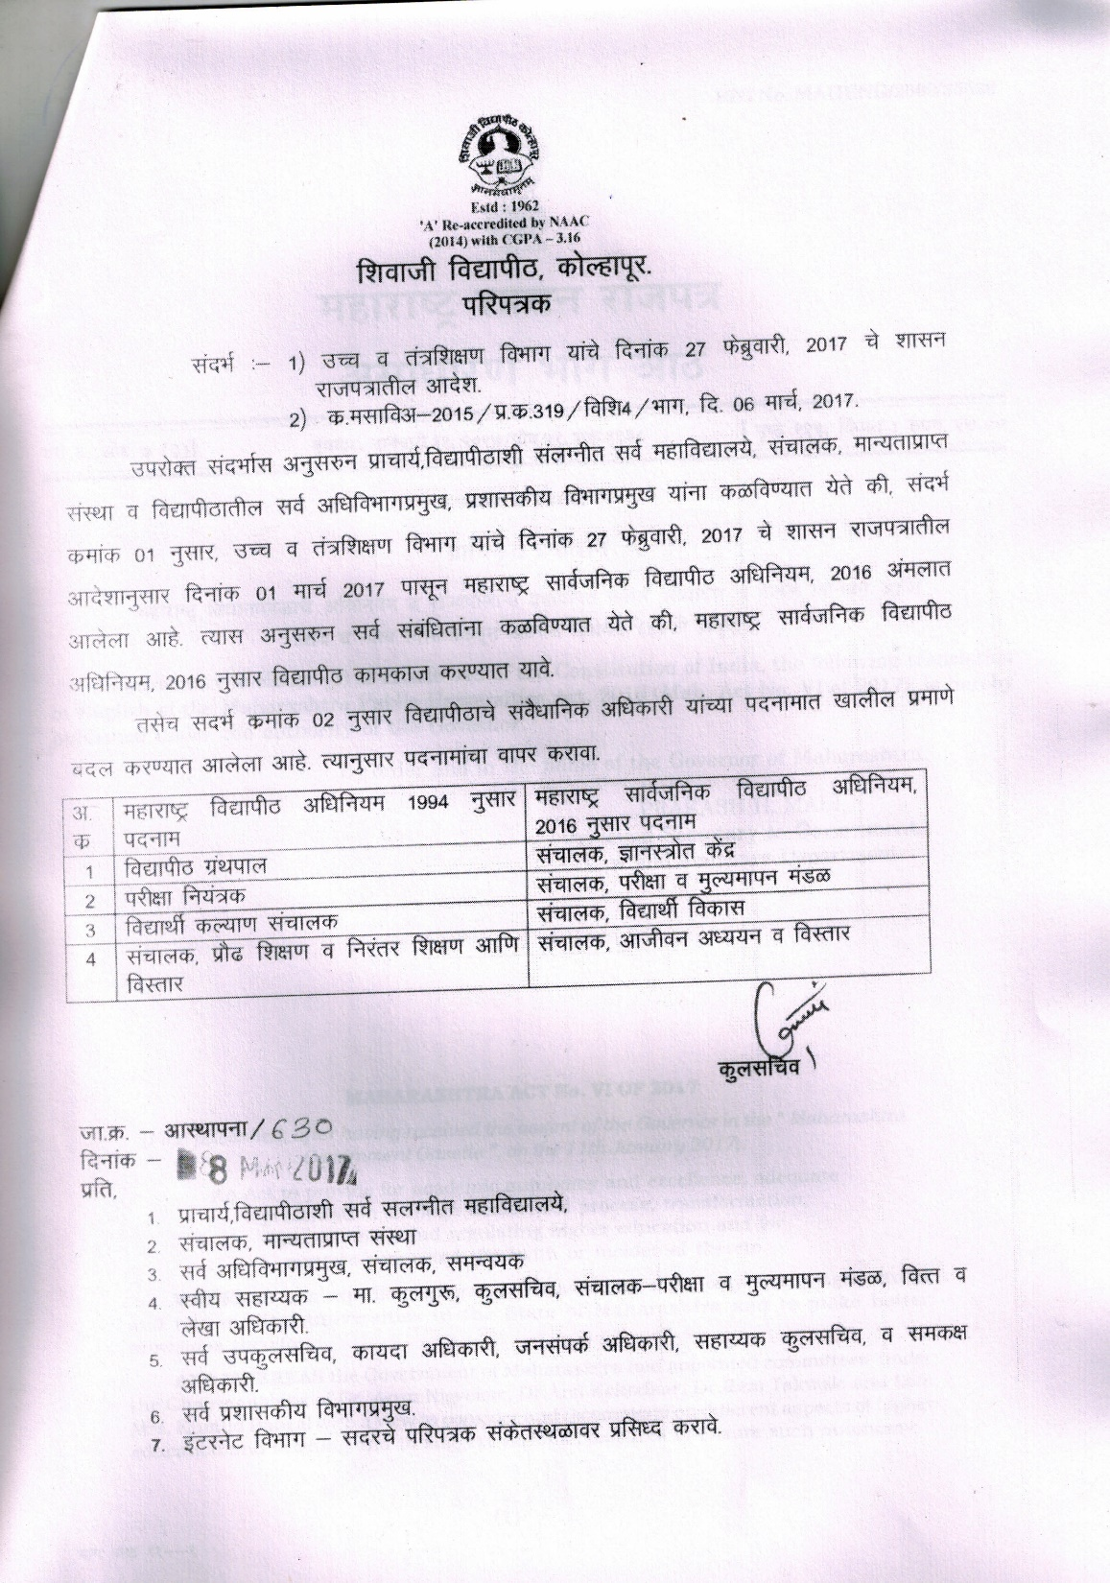

Slide 38


A New Beginning
HIGH COURT OF GUJARAT –MEDIATION

Slide 39


